Slide 1
CEDAC
Cause and Effect Diagram with the Addition of Cards
Notes:
NOTE: The CEDAC training module is intended for use at kaizen event training. The training is a “Learn-Do” approach in which there are designated points in the training course for the participants/kaizen teams to stop and apply their learning to their kaizen project/event. The training material is recommended for a 5 day event, but is scalable for events of any length.

Slide 2

Other Modules In This Series:
5S
Standard Work
Total Productive Maintenance (TPM)
Administrative Lean
Cell Design/ Production Preparation Process (3P)
Kaizen
Kanban
Problem Solving
Poka Yoke Quality Systems
Transaction Process Improvement (TPI)
Cause & Effect Diagram with the Additions of Cards (CEDAC)
Single Minute Exchange of Dies (SMED)
Value Stream Mapping (VSMi®)
Visual Management
Managing Daily Process Excellence
For More Information Please Contact:
Mark DeLuzio, President and CEO
+1.860.234.0915
mark.deluzio@leanhorizons.com
Strategically Creating Value Through the Elimination of Waste

Slide 3
This document contains confidential
and proprietary information owned
by Lean Horizons Consulting, LLC.
Any disclosure, use, copying or
distribution of this information without the express written consent of Lean Horizons Consulting is strictly prohibited.

Slide 4
Ground Rules for Event
Safety first (use personal protective equipment)
Active participation by all
Start and end on time
All electronic gadgets (phones, pagers, etc) turned to “off” or “silent”
Computers to be used only when instructed
Keep an open mind to change
Don’t let “perfect” get in the way of “better”
Notes:
DO: Perform Group Introductions. Pick an ice-breaker or exercise to warm the team up to the event. (Icebreaker Example: Everyone uses their name tent and writes a “Personal License Plate” in which they have 2 minutes to creatively use a total of 7 letters or numbers to tell us something about themselves. Examples “LV2SAIL” OR “DADOV5”
DO: Review Event Ground Rules.
ASK: “Does anyone have any rules they would like to see added?”
ASK: “Does everyone agree to these?”

Slide 5
Goal of CEDAC Module
To solve complex business and technical problems through the
effective use of the CEDAC tool and method.
Overview
Problem
Effect
Problem
Cause
Problem
Solution
Review
Notes:
DO: Introduce the notion of CEDAC and the goal of this event.
SAY: “The major objectives of this module are that we want you to:
1 - Understand and utilize the customer-focused Problem Solving Process
2 - Develop a working knowledge of how and when to use the basic tools to solve problems
3 - Learn the fundamentals of CEDAC (Cause and Effect Diagram with the Addition of Cards)
4 - Improve the ability to creatively solve problems and initiate positive change”

Slide 6
Typical CEDAC Event Agenda
Day | Key Learnings | Daily Deliverables
Day 1 | CEDAC Overview | “CEDAC Chart (Process flowchart or fishbone) on wall “Effect” side posted on CEDAC Chart
Day 2 | Using FACT Cards to identify root causes | Electronic capture of process flowchart or fishbone and “Effect” Side of chart FACT Cards posted on CEDAC chart
Day 3 | Using IMPROVEMENT Cards to propose countermeasures | IMPROVEMENT Cards Posted on CEDAC chart Electronic capture of FACT Cards and IMPROVEMENT Cards
Day 4 | Prioritizing and acting on IMPROVEMENT Cards Post-event Follow-up and tracking to problem resolution | Selected IMPROVEMENT Cards marked for action Electronic Capture of IMPROVEMENT Card action and status Follow-up Plan
Day 5 |  | Report out
Notes:
SAY: “While not all CEDAC events are 5 full days this represents the preferred method of improvement to ensure that the systematic approach is followed.”

Slide 7
Exercise: CEDAC Charter Review
Objective
Review the CEDAC Charter for the event.
Instructions
Time to Complete
As a team review the event charter and answer the following questions:
What is the business need for this event?
Who is the owner?
What are the clear boundaries?
What is the scope for this event?
What are the goals for this event?
15 minutes
Deliverable
Make any modifications
to charter as necessary.

Slide 8
CEDAC
CEDAC Overview
CEDAC Effect
CEDAC Cause
CEDAC Solution
CEDAC Review
Objectives:
Define CEDAC
When to use CEDAC
Identify steps of the CEDAC Roadmap and Process
Review examples of success with CEDAC
Notes:
DO: Review chapter objectives.

Slide 9
CEDAC Defined
Overview
Cause and Effect Diagram with the Addition of Cards
An extension of traditional cause and effect diagram (aka: Fishbone diagram)
Used in a team-based environment to solve problems by categorizing root causes and testing countermeasures
Notes:
SAY: “The Ishikawa diagram (also fishbone diagram or cause and effect diagram) is the brainchild of Kaoru Ishikawa, who pioneered quality management processes in the Kawasaki shipyards, and in the process became one of the founding fathers of modern management. It is simply a diagram that shows the causes of a certain event. It was first used in the 1960s, and is considered one of the seven basic tools of quality management, along with the histogram, Pareto chart, check sheet, control chart, flowchart, and scatter diagram.”

Slide 10
When to Use CEDAC
Overview
When addressing complex business or technical problems
When there are perceived to be multiple root causes of the problem and multiple countermeasures required to fully solve the problem
Where the resolution of the problem is likely to exceed one week
Where cross-functional expertise is required in order to understand all aspects of the problem and its solution
Where prior attempts using other problem-solving tools and methods have failed to solve the problem
When a systematic, structured approach and process is required
Notes:
SAY: “CEDAC is also a great tool to get to root cause and involve not only those on the actual event team but also those on other shifts and from other areas. Anyone can fill out cards as long as they follow the basic rules.”

Slide 11
Steps of the CEDAC Process
Overview
Define problem
Establish and validate metrics
Determine Objective Statement
Create CEDAC diagram (Flowchart, Fishbone, etc.)
Brainstorm and create FACT Cards (in yellow) and post on diagram
Brainstorm and create IMPROVEMENT Cards (in blue) and post on diagram
Take action on the IMPROVEMENT cards
Institutionalize improvements (countermeasures) that have proven to solve the problem
The “Effect”
The “Cause”
The “Solution”
(countermeasures)
Notes:
SAY: “Defining the problem in step 1 is what is thought to be the issue although it may turn out differently when inputs and fact finding occur. Don’t let the problem define the correction action if it is not the true problem.
Taichi Ohno (the father of TPS) says that 80% of our time should be spent defining and proving the true root cause problem, not fixing it.
Traditionally, most “problem solvers” already know what the problem is and have a solution but most often there was no systematic approach to determine the true problem/s and they jump to the solution phase without allowing others to contribute.
The PDCA cycle is inherently incorporated into CEDAC along with the 5-why’s.”

Slide 12
CEDAC Roadmap
Overview
Repeat until problem is solved
PROCESS STEP 1
PROCESS STEP 2
PROCESS STEP 3
PROCESS STEP 4
Conduct CEDAC Planning Workshop
Conduct CEDAC
Event
Implement and Test Countermeasures
Conduct CEDAC Follow-up Workshops
Identify the Problem
Validate problem using metrics
Identify target
(When is the problem solved?)
Plan CEDAC Event
CEDAC Chart
FACT Cards posted
IMPROVEMENT Cards posted
IMPROVEMENT Cards marked for action
Follow-up Plan
Countermeasure Test results
Problem / target metric tracking
IMPROVEMENT CARDS marked for action
Additional FACT Cards
Additional IMPROVEMENT Cards
Changes and adjustments to countermeasure priorities and implementation plans
Notes:
DO: Discuss each step and the activities under each box one by one. Following this process will allow the team to learn the stepped process to solve problems to the root level.

Slide 13
CEDAC Pre-Event Process
Overview
Repeat until problem is solved
PROCESS STEP 1
PROCESS STEP 2
PROCESS STEP 3
PROCESS STEP 4
Conduct CEDAC Planning Workshop
Conduct CEDAC
Event
Implement and Test Countermeasures
Conduct CEDAC Follow-up Workshops
CEDAC Process Steps 1-3
Define
Problem
Establish and Validate
Metrics
Determine Objective Statement
Notes:
NOTE: This slide refers to the main phases of planning that must be carried out prior to the event week but should include critical members of the team and or management responsible for the process being reviewed.

Slide 14
CEDAC Event Process
Overview
Repeat until problem is solved
PROCESS STEP 1
PROCESS STEP 2
PROCESS STEP 3
PROCESS STEP 4
Conduct CEDAC Planning Workshop
Conduct CEDAC
Event
Implement and Test Countermeasures
Conduct CEDAC Follow-up Workshops
CEDAC Process Steps 4-8
Create
CEDAC Diagram / Fishbone
Chart
Develop
FACT
Cards
Develop
IMPROVEMENT Cards
Act on
IMPROVEMENT Cards
Develop
Follow-up
Plan
Notes:
NOTE: These steps reference the items that will be addressed during the event and throughout the CEDAC activity if the CEDAC is used outside of the team.
SAY: “CEDAC is a good tool used for multi-shift operations and in environments that need input from areas that are not included on the team.”

Slide 15
CEDAC Example: Cash Collection Process
Overview
PROBLEM STATEMENT
TARGET
Monthly performance is not consistent – bad results come after good and the key drivers for this inconsistency are not well understood
Collections performance often falls short of targets set / does not meet customer expectations
Improve customer satisfaction by creating a collections process capable of consistently hitting established targets. Want to consistently hit 90% or better for current debt %.
Reduce month to month variation in performance and improve consistency of results.
Put a simple, robust collections model in place to be replicated in other business streams.
Create an improvement model (the event and tools) that can be leveraged across other business streams.
Notes:
NOTE: Specific company name and information have been removed from this example.

Slide 16
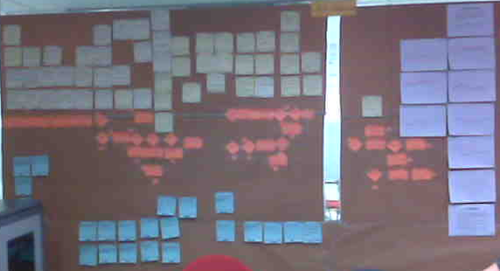
CEDAC Example: Cash Collection Process
Overview

Slide 17
CEDAC Example: Cash Collection Process
Overview
Summary of Findings:
52 potential root causes identified (FACT Cards)
Collections process too long
Lack of clear information being secured prior to the billing process
Collectors’ techniques and skill levels vary (e.g. escalation process)
Inconsistent knowledge of products by the Collectors
Stability and response time issues with system
All collection tools functionality not being used (e.g. Reminders)
All steps in the collections process not being followed consistently
Every customer, regardless of dollar value, follows the same collection process – no formal method for prioritization

Slide 18
CEDAC Example: Cash Collection Process
Overview
Summary of Key Improvements:
23 Improvements identified (18 to be started immediately)
Collector training (techniques, tools, products)
Cleanse unneeded data from system (e.g. old reminders)
Bulk upload of latest activity information into system
Automation of dunning letters and statements
Work with subsidiaries to improve the quality of information
Implement tracking system for telephone calls
Capture customer payment history to better enable future collections

Slide 19
CEDAC Step 1 - Define the Problem
CEDAC Overview
CEDAC Effect
CEDAC Cause
CEDAC Solution
CEDAC Review
Objectives:
Define elements of a problem statement
Define problem in terms of its effect
Identify common pitfalls
Critique sample problem statements
Notes:
DO: Review chapter objectives.

Slide 20
Steps of the CEDAC Process
CEDAC Problem Effect
Define problem
Establish and validate metrics
Determine Objective Statement
Create CEDAC diagram (Flowchart, Fishbone, etc.)
Brainstorm and create FACT Cards (in yellow) and post on diagram
Brainstorm and create IMPROVEMENT Cards (in blue) and post on diagram
Take action on the IMPROVEMENT cards
Institutionalize improvements (countermeasures) that have proven to solve the problem
The “Effect”
The “Cause”
The “Solution”
(countermeasures)
Notes:
SAY: “Defining the problem does not mean define the solution. Simply state what the observed failure or defect is and let the process amplify the “who, what, where, when” that will lead to the “why.””
Objective statement = goal or desired condition

Slide 21
Elements of a CEDAC Problem Statement
CEDAC Problem Effect
A Problem Statement should describe the problem in terms of its specific effect on the process or on the business
Should be clear and concise – one sentence ideal
Should be as specific as possible – to ensure that we are solving one problem and not many
Should be based on data and quantifiable
Should not contain embedded solutions or perceived root causes

Slide 22
Common Pitfalls in CEDAC Problem Statements
CEDAC Problem Effect
Too vague or too large
  Example: Customer satisfaction is an all-time low
  Remedy: Redefine the problem so that it is clear and concise, can be easily validated by the stakeholders and will better focus the scope of the CEDAC project.
  Better Example: The percentage of customer applications processed and decisioned within the 30 minute committed response time has fallen to 73% in the past month as measured by the Daily Response Time Report
Not specific enough
  Example: The Small Housing Cell has a 25% reject rate
  Remedy: Narrow the problem to where the effect has specifically been observed to avoid a CEDAC scope that is larger than necessary.
  Better Example: The first grinding operation in Small Housing Cell has been experiencing a 25% reject rate in O.D. dimension on the 122A-1 product

Slide 23
Common Pitfalls in CEDAC Problem Statements
CEDAC Problem Effect
Problem identified as the absence of the solution
  Example: We don’t have good Project Management Software to track and manage our engineering projects
  Remedy: If the embedded solution (e.g. new project management software) is really all that is needed, then don’t do CEDAC – just implement the solution. Otherwise, get away from the solution and restate the problem in terms of its effect.
  Better Example: 80% of our engineering projects have had cost overruns by more than 20% and 60% have missed their delivery dates by at least a month
Root causes embedded in the Problem Statement
  Example: Poor maintenance practices are causing milling machine #4 to produce defects
  Remedy: This is a hypothesis at best that will divert the CEDAC team from discovering other possibilities which may be the true root cause. Remove the causal reference and re-state the problem in terms of its effect.
  Better Example: The milling operation performed by milling machine #4 is experiencing a defect rate of 22% on the AB225-1 product

Slide 24
Common Pitfalls in CEDAC Problem Statements
CEDAC Problem Effect
Multiple problems (effects)
  Example: Employee turnover in the warehouse has risen to 28% over the last year causing inventory accuracy to fall to 73%
  Remedy: While these two problems may seem to be related, they are really separate problems with different solutions (countermeasures). Separate into two CEDAC projects with separate problem statements. This also removes the causal relationship that is implied.
  Better Example (CEDAC #1): Employee turnover in the warehouse has risen to 28% over the last year
  Better Example (CEDAC #2): Inventory accuracy in the warehouse has fallen to 73% as measured by daily cycle count reports

Slide 25
CEDAC Step 1 Exercise: Critique sample problem statements
CEDAC Problem Effect
Objective
Given sample problem statements, critique and rewrite if necessary each problem statement.
Instructions
Time to Complete
In pairs, critique each of the problem statements on the following slide against the criteria outlined on the previous slides.
If necessary, re-write the problem statements to make more effective.
15 minutes
Deliverable
Report out on evaluation for each
problem statement.

Slide 26
Sample Problem Statements
CEDAC Problem Effect
Sample Problem Statements | Critique
1. Our monthly sales forecasts are only 60% accurate causing stock-outs in the warehouse
2. Poor packaging is causing products to be delivered to the customer with damage
3. We don’t have a good training course for our field technicians to diagnose and repair products
4. We need a new a grinding machine capable of holding the inside diameter dimension tolerance on part # AB006-2
Notes:
Better versions of these Problem Statements:
The number of stock-outs in the warehouse has risen to 15% over the last three months,
failing to meet our service level objective of 98% fill rate on all orders
2. Over the last three months, 85 out of 630 customer orders shipped for the AC001 line of products resulted in
claims of product damage by the customer as measured by incoming claims received in Customer Service
Here are three different possible examples:
3.1. Field repairs are taking longer to make in the past year on average than in previous history
(5.2 average hours last year compared to 2.3 average hours over the prior three years)
3.2. 30% of all products that were repaired in the field last year had to be repaired a second time
3.3 30% of all failed products in the field could not be repaired in the field and had to be returned to the factory
4. 15% of the Part# AB006-2’s produced in the large ring cell are rejected for out-of-spec inside diameter during CMM inspection

Slide 27
Case Study Exercise: CEDAC Step 1 – Define Problem
CEDAC Problem Effect
Objective
Analyze Case Study
Instructions
Time to Complete
Divide into small groups of 3-4 persons/team
In each team, review the situation from the case study on the following slide
Given what you know thus far, create a problem statement
Record problem statement on chart paper for review with class
5 minutes
Deliverable
Problem Statement – one person to report out to rest of class
Notes:
NOTE: At this point, probably the best problem statement would be: “Customer complaints have increased significantly during this past summer.” The learners may struggle given that there is no additional data, and that is GOOD! There is really no wrong answer at this point, since the teams will have an opportunity to more data in steps 2 and 3.
NOTE: This restaurant is NOT REAL! In case anyone should ask – only a hypothetical situation.

Slide 28
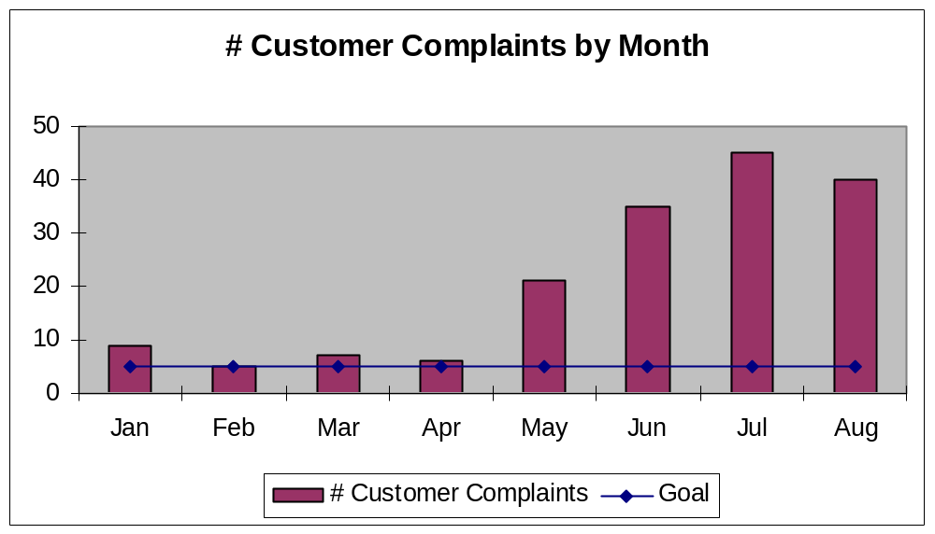
Sample Case Study – “Spencer’s” Restaurant
CEDAC Problem Effect
“Spencer’s” is a popular restaurant in Blacksburg, Virginia, located right next to Virginia Tech.
It has been open for nine years and has enjoyed increased annual business revenue every year.
Spencer’s offers a nice variety of American, Italian and German food. It is open for lunch and dinner.
Spencer’s is looking forward to the return of the college students next month, since that always means more business.
While the restaurant has had a profitable summer, it has seen a substantial increase in customer complaints.
Spencer’s has a good rapport with its customers and wants to eliminate these complaints before business ramps back up in the next month.

Slide 29
CEDAC Step 2 – Establish and Validate Metrics
CEDAC Overview
CEDAC Effect
CEDAC Cause
CEDAC Solution
CEDAC Review
Objectives:
Explain why metrics are essential to solving problems
Characterize an appropriate metric as it relates to a problem
Differentiate quantitative versus qualitative metrics
Identify common pitfalls
Evaluate sample metrics
Notes:
DO: Review chapter objectives.

Slide 30
Steps of the CEDAC Process
CEDAC Problem Effect
Define problem
Establish and validate metrics
Determine Objective Statement
Create CEDAC diagram (Flowchart, Fishbone, etc.)
Brainstorm and create FACT Cards (in yellow) and post on diagram
Brainstorm and create IMPROVEMENT Cards (in blue) and post on diagram
Take action on the IMPROVEMENT cards
Institutionalize improvements (countermeasures) that have proven to solve the problem
The “Effect”
The “Cause”
The “Solution”
(countermeasures)

Slide 31
Metrics are Essential
CEDAC Problem Effect
Provide an objective measure of the “health” of a process and give clear direction for problem solving
  Personal health measures: weight, blood pressure, cholesterol levels
  Automobile measures: oil level, gas mileage, tire pressure, temperature
Without metrics, you may not solve the correct problem or you may be “solving” something that isn’t a problem at all!
Provide feedback around the impact of the solutions you implement
Enable sustainability and further improvement
Notes:
SAY: “You cannot improve what you don’t measure.”

Slide 32
Characteristics of Appropriate Metrics
CEDAC Problem Effect
Measurable and specific
Cover appropriate time period reflective of entire process
Easy to capture, read and understand
Detailed to enable root cause resolution
Customer focused
Lead to action
Include clear ownership
Notes:
SAY: “It is important to collect and use measures that are easy to get and hard to fool. If the measures can be “gamed” then they probably will be…”

Slide 33
Differentiate Qualitative versus Quantitative metrics
CEDAC Problem Effect
Qualitative | Quantitative
It is hot | It is 100 degrees F
Quality is poor | First pass yield has decreased from 90% to 60%
Customers are not happy | Customer complaints have tripled in the last month
Morale is low | Employee turnover is 46%
Notes:
DO: Ask the team to identify some of their own metrics (personal or professional) based on what they interpret here.

Slide 34
Common Pitfalls to Determining Metrics
CEDAC Problem Effect
Measurement too broad
Metric not actionable
Data not taken over long enough period
Data too difficult to capture
Inconsistent data collection
Lack of a goal
Too many items in a “miscellaneous” category
Metric inadequately deployed
Notes:
NOTE: It is helpful to expand on each of the items listed and ask the class what they mean and how they relate to their experience. Don’t let them off easy, make them tell you some instances for some of the items listed to be sure they relate to the pitfalls and find the truth in what is being taught.

Slide 35
CEDAC Step 2 Exercise: Critique sample metrics
CEDAC Problem Effect
Objective
Given sample problem statements and metrics, critique and rewrite if necessary each metric.
Instructions
Time to Complete
In pairs, critique each of the metrics as they correspond to the problem statements on the following slide against the criteria outlined on the previous slides.
If necessary, re-write the metrics to make more effective.
15 minutes
Deliverable
Report out on evaluation for each
problem statement and metric

Slide 36
Exercise: Critique sample metrics
CEDAC Problem Effect
PROBLEM STATEMENT | METRIC | CRITIQUE
1. The number of stock-outs in the warehouse has risen to 15% over the last three months | Inventory inaccuracy
2. Over the last three months, 85 out of 630 customer orders shipped for the AC001 line of products resulted in claims of product damage by the customer | Daily on-time-delivery to customer demand
3. 30% of all products that were repaired in the field last year had to be repaired a second time | Customer satisfaction
4. There is inadequate budget to hire a new accountant | Daily Account Receivables $$
Notes:
ANSWERS:
Metric does not directly correlate to problem
Adequate
Customer satisfaction ratings may apply to this depending on what was measured – but the metric as it is written is not clear.
Daily account receivables does not point directly to available budget for an accountant

Slide 37
Case Study Exercise: CEDAC Step 2 – Establish/Validate Metrics
CEDAC Problem Effect
Objective
Analyze Case Study
Instructions
Time to Complete
In each team, review the additional metrics from the case study on the following slide
Given this new data, evaluate and refine your problem statement
Discuss what other data may be necessary to get to root cause and solve the problem
Record problem statement and list of potential metrics on chart paper for review with class
10 minutes
Deliverable
Problem Statement and list of other potential metrics– one person to report out to rest of class
Notes:
NOTE: At this point, probably the best problem statement would be: “Customer complaints have increased significantly during this past summer, primarily on Fridays.” Additional metrics would definitely include a Pareto analysis of the actual COMPLAINTS, especially on Friday. You may want to point out that, at this point, your primary focus WILL be on FRIDAY complaints, given that it accounts for 80% of the problem.

Slide 38
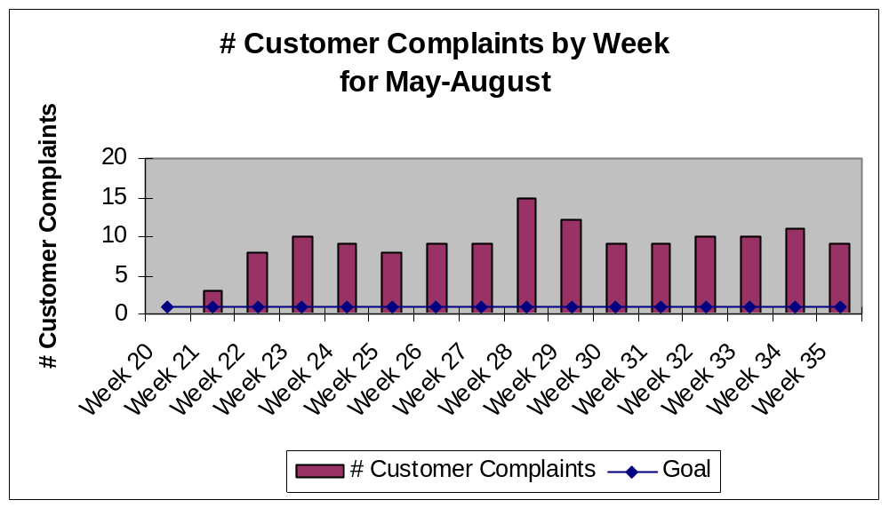
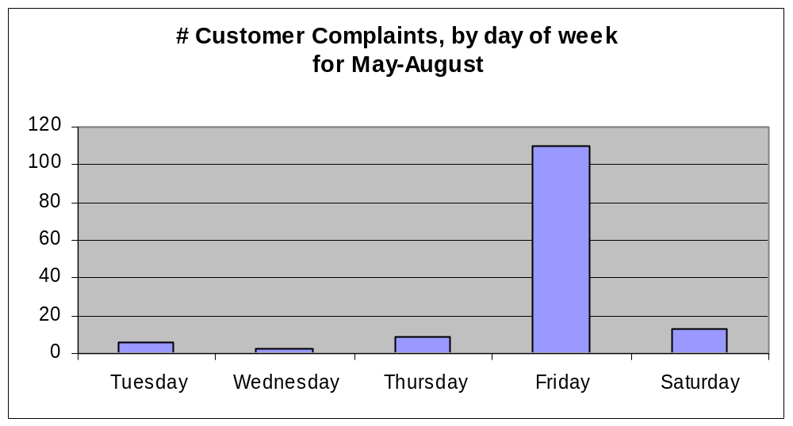
Sample Case Study – “Spencer’s” Restaurant
CEDAC Problem Effect
Notes:
SAY: “Don’t forget Pareto’s Law and the 80/20 rule…
The original observation was in connection with income and wealth. Pareto noticed that 80% of Italy's wealth was owned by 20% of the population. He then carried out surveys on a variety of other countries and found to his surprise that a similar distribution applied.
It also applies to a variety of more mundane matters: we wear our 20% most favored clothes about 80% of the time, we spend 80% of the time with 20% of our acquaintances etc.
The Pareto principle has many applications in quality control. It is the basis for the Pareto chart, one of the key tools used in total quality control and six sigma. The Pareto principle serves as a baseline for ABC-analysis and XYZ-analysis, widely used in logistics and procurement for the purpose of optimizing stock of goods, as well as costs of keeping and replenishing that stock.
In computer science the Pareto principle can be applied to resource optimization by observing that 80% of the resources are typically used by 20% of the operations. In software engineering, it is often a better approximation that 90% of the execution time of a computer program is spent executing 10% of the code (known as the 90/10 law in this context).
In business, dramatic improvements can often be achieved by identifying the 20% of customers, activities, products or processes that account for the 80% of contribution to profit and maximizing the attention applied to them. Similarly a vast majority of the business risk is contained in few risk scenarios. The greatest reduction in risk may therefore be focused in this area.”

Slide 39
CEDAC Step 3 – Determine Objective Statement
CEDAC Overview
CEDAC Effect
CEDAC Cause
CEDAC Solution
CEDAC Review
Objectives:
Define objective in terms of problem solving
Explain purpose of setting objective
Identify examples of well-defined objectives
Review CEDAC charter and validate the problem statement, metrics, and objective
Notes:
DO: Review chapter objectives.

Slide 40
Steps of the CEDAC Process
CEDAC Problem Effect
Define problem
Establish and validate metrics
Determine Objective Statement
Create CEDAC diagram (Flowchart, Fishbone, etc.)
Brainstorm and create FACT Cards (in yellow) and post on diagram
Brainstorm and create IMPROVEMENT Cards (in blue) and post on diagram
Take action on the IMPROVEMENT cards
Institutionalize improvements (countermeasures) that have proven to solve the problem
The “Effect”
The “Cause”
The “Solution”
(countermeasures)
Notes:
NOTE: Objective = goal

Slide 41
Define Objective
CEDAC Problem Effect
“Objective” is the end result you expect from your problem solving activities and actions – the target for problem resolution
The objective should be:
  Detailed and specific
  Action-oriented
  Measurable
  Aggressive and realistic
  Stated within specific time frame
  Written

Slide 42
Explain Purpose of Setting the Objective
CEDAC Problem Effect
Defines current situation
Enables owner to gain clarity and focus
Communicates direction to team members
Establishes what “winning” looks like
Builds a success-oriented culture

Slide 43
Examples of Well-Defined Objectives
CEDAC Problem Effect
Improve first pass yield at first assembly operation from 75% to 95% by end of October
Reduce number of customer complaints by 50%, from 10/day to 5/day, within next month
Increase sales in the medical market by $100k per month, by the end of this year
Eliminate order entry errors, from 7/day to zero, by the close of this quarter
Notes:
NOTE: Be sure that this statement is clear and completely addresses the issue.
SAY: “An improvement on any of the statements above would be to add “as measured by _____”. Can the class add anything else?”

Slide 44
Case Study Exercise: CEDAC Step 3 – Objective Statement
CEDAC Problem Effect
Objective
Analyze Case Study
Instructions
Time to Complete
In each team, review the additional metrics from the case study on the following slide
Given this new data, determine your objective statement
Record objective statement on chart paper for review with class
10 minutes
Deliverable
Objective statement– one person to report out to rest of class
Notes:
NOTE: The best objective statement would be something like: “Reduce waiting time for order taking on Fridays from x to y by middle of September.”
Don’t forget how it will or could be measured…

Slide 45
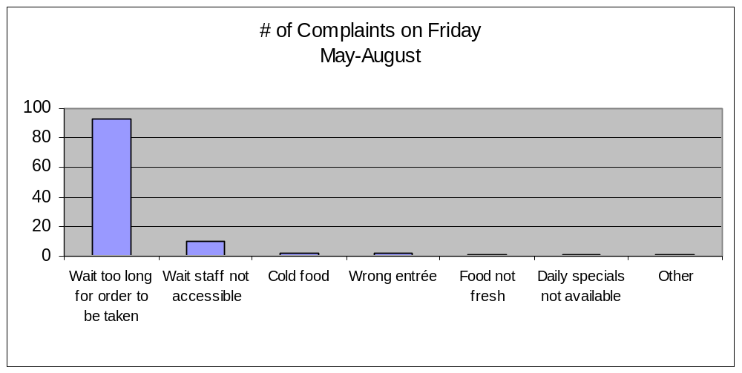
Sample Case Study – “Spencer’s” Restaurant
CEDAC Problem Effect

Slide 46
CEDAC Step 3 Exercise: Validate event charter
CEDAC Problem Effect
Objective
Evaluate the CEDAC event charter in terms of key learnings about Problem Statements, Metrics, and Objectives
Instructions
Time to Complete
As a team, review the CEDAC Event Charter and validate that we have the right Problem Statement, Metrics, and Objective.
Make any needed modifications.
20 minutes
Deliverable
Validated Event Charter
Notes:
SAY: “When beginning, first write the problem statement and agree to this as a team. Then, write the objective statement – which is what you want to accomplish. The objective statement should be a quantifiable statement with set measurement criteria and established target dates. Include any supporting data such as a visual measurement graph.”

Slide 47
CEDAC Step 4 - Create CEDAC Diagram
CEDAC Overview
CEDAC Effect
CEDAC Cause
CEDAC Solution
CEDAC Review
Objectives:
Identify various formats for CEDAC and review example of each
Identify when to use each format
Identify steps to construct a Fishbone Diagram
Identify steps to construct a Process Flow Chart
Determine which format will be used for this CEDAC event
Notes:
DO: Review chapter objectives.

Slide 48
Steps of the CEDAC Process
CEDAC Problem Cause
Define problem
Establish and validate metrics
Determine Objective Statement
Create CEDAC diagram (Flowchart, Fishbone, etc.)
Brainstorm and create FACT Cards (in yellow) and post on diagram
Brainstorm and create IMPROVEMENT Cards (in blue) and post on diagram
Take action on the IMPROVEMENT cards
Institutionalize improvements (countermeasures) that have proven to solve the problem
The “Effect”
The “Cause”
The “Solution”
(countermeasures)
Notes:
DO: Use a flipchart or dry-erase board to create a model diagram for the team to use.

Slide 49
Various Formats for CEDAC
CEDAC Problem Cause
Fishbone (Ishikawa) diagram
Process flow map
Diagram of product
Diagram (layout) of work area
Notes:
SAY: Format provides a framework for arranging fact and improvement Cards (explained later). Use whatever works best for your situation; There is no right or wrong format. If in doubt, use the Cause and Effect Fishbone Diagram.
The Ishikawa diagram (also fishbone diagram or cause and effect diagram) is the brainchild of Kaoru Ishikawa, who pioneered quality management processes in the Kawasaki shipyards, and in the process became one of the founding fathers of modern management. It is simply a diagram that shows the causes of a certain event. It was first used in the 1960s, and is considered one of the seven basic tools of quality management, along with the Histogram, Pareto chart, check sheet, control chart, flowchart and scatter diagram.
It is known as a fishbone diagram because of its shape.

Slide 50
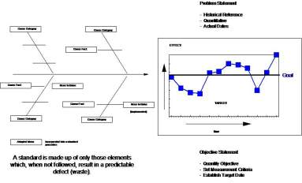
CEDAC Format #1 - Fishbone
CEDAC Problem Cause
Fishbone diagram
Definition
Consolidates a succinct picture of cause and effect relationships
Uses major categories to stimulate possible causes
Identifies root causes
When to Use
Simple processes
Specific problems
Answer, why is there variation?
Notes:
SAY: Format provides a framework for arranging fact and improvement Cards (explained later). Use whatever works best for your situation; There is no right or wrong format. If in doubt, use the Cause and Effect Fishbone Diagram.
The Ishikawa diagram (also fishbone diagram or cause and effect diagram) is the brainchild of Kaoru Ishikawa, who pioneered quality management processes in the Kawasaki shipyards, and in the process became one of the founding fathers of modern management. It is simply a diagram that shows the causes of a certain event. It was first used in the 1960s, and is considered one of the seven basic tools of quality management, along with the Histogram, Pareto chart, check sheet, control chart, flowchart and scatter diagram.
It is known as a fishbone diagram because of its shape.

Slide 51
Steps to Construct a Fishbone Diagram
CEDAC Problem Cause
Place effect (problem statement) in box on far right, along with metrics exemplifying the problem
Extend fishbone to the left of problem statement
Major bones (categories) are drawn as 45 degree feeder lines from the horizontal line
Label the six categories using six “M’s” or eight “P’s”
  Man, Machines, Methods, Materials, Measurement, Mother Nature
  People, Procedures, Policies, Plant/Place, Performance, Planet, Price, Promotion
  Price, Promotion, People, Processes, Place / Plant, Policies, Procedures & Product (or Service)
Notes:
SAY: When creating the FACT cards using the categories, don’t get caught up in debating in which “category” the card should be placed. These categories are primarily used to stimulate ideas and systemic thinking.
The 6 M's
Machine, Method, Materials, Measurement, Man and Mother Nature (Environment) (recommended for manufacturing industry). Note: a more modern selection of categories used in manufacturing are Equipment, Process, People, Materials, Environment, and Management
The 8 P's
Price, Promotion, People, Processes, Place / Plant, Policies, Procedures & Product (or Service) (recommended for administration and service industry).
Other: The 4 S's
Surroundings, Suppliers, Systems, Skills (recommended for service industry).
When labeling place any of the above at the end of the leg where you chose. It is not important the location or proximity to other topics but there should be one leg of the fishbone for each topic.

Slide 52

CEDAC Format #2 – Process Flow Map
CEDAC Problem Cause
Process Flow Map
Definition
Displays each major step within the process
Links causes to specific process steps
When to Use
Complex processes
Unknown where/when the problem is occurring
Notes:
ASK: “Why use a process map?” and have the class submit suggestions.
ASK: “Is there often a difference from what we think happens to what truly happens”.
“Do we all do or see things differently and could that cause variation?”

Slide 53
Steps to construct a Process Flow Chart
CEDAC Problem Cause
Start with the INPUT into the process (indicated by an oval shape)
Ask, “what happens next?” and record each process step in a rectangular box
Use a diamond shapes to indicate decision points in the process
Connect steps (boxes and diamonds) using arrows to indicate flow
Conclude with OUTPUT of the process (also indicated by an oval shape)
Notes:
NOTE: It may be beneficial (depending on audience) to construct a process flow chart for something simple like writing on a flip chart (beginning with get up from chair and end with sit back down). This simple process will show several different opinions about how it should work and you will be able to demonstrate how what is thought to happen can differ from what does happen. Have the class observe you doing the process and then have them map your actions out.
Discuss the results and thoughts.

Slide 54
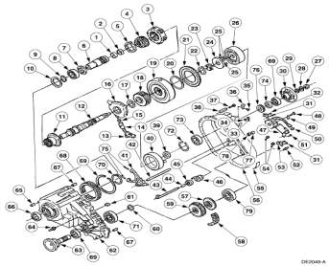
CEDAC Format #3 – Diagram of Product
CEDAC Problem Cause
Diagram of Product
Definition
Drawing of the product itself
Relates possible causes to locations on the product
When to Use
Very specific product
Complex design

Slide 55
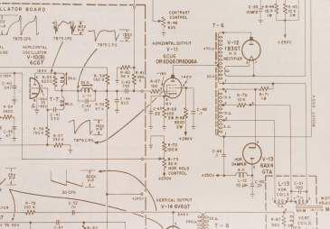
CEDAC Format #4 – Layout of Area
CEDAC Problem Cause
Picture of Format
Definition
Physical layout of problem area
Relates possible causes to locations within the area
When to Use
Systemic problems in environment

Slide 56
Case Study Exercise: CEDAC Step 4 – Create CEDAC diagram
CEDAC Problem Cause
Objective
Analyze Case Study
Instructions
Time to Complete
In each team, review the process flow map from the case study on the following slide
Given your problem statement, objective statement and metrics, decide which CEDAC format to use for this case study
Draw CEDAC diagram on chart paper for review with class
10 minutes
Deliverable
CEDAC diagram– one person to report out to rest of class
Notes:
SAY: Be sure to include the objective statement and supporting metrics on the diagram.
NOTE: The best format would be the fishbone diagram, since the process is very simple and ALL the cards would be placed on the second process step where the “order is taken.”

Slide 57
Sample Case Study – “Spencer’s” Restaurant
CEDAC Problem Cause
Hungry customer
Customer enters, is greeted and seated with menu
Customer reviews menu and order is taken by server
Customer is served food and presented with check
Customer pays and completes survey form
Satisfied, FULL customer

Slide 58
CEDAC Step 4 Exercise: Determine Format for CEDAC
CEDAC Problem Cause
Objective
Determine which format will be used for this CEDAC event.
Instructions
Time to Complete
As a team, determine which format will be used for this CEDAC event.
Create the decided format on the wall of the training room in preparation to begin the next part of the CEDAC process.
It is recommended that one team member captures the format electronically.
20 minutes
Deliverable
Format agreed upon and transferred to “the wall” of the training room.

Slide 59
CEDAC Step 5 - Develop FACT Cards
CEDAC Overview
CEDAC Effect
CEDAC Cause
CEDAC Solution
CEDAC Review
Objectives:
Define FACT Cards and how they are used
Describe the detail of the format for a FACT Card and review example
Describe process for developing and posting the FACT Cards
Complete development of FACT Cards for business problem
Conduct team review of FACT Cards
Notes:
DO: Review chapter objectives.

Slide 60
Steps of the CEDAC Process
CEDAC Problem Cause
Define problem
Establish and validate metrics
Determine Objective Statement
Create CEDAC diagram (Flowchart, Fishbone, etc.)
Brainstorm and create FACT Cards (in yellow) and post on diagram
Brainstorm and create IMPROVEMENT Cards (in blue) and post on diagram
Take action on the IMPROVEMENT cards
Institutionalize improvements (countermeasures) that have proven to solve the problem
The “Effect”
The “Cause”
The “Solution”
(countermeasures)
Notes:
SAY: There are no bad ideas when it comes to brainstorming. Everyone should be encouraged to offer up ideas that could represent the problems or issues.

Slide 61
FACT Cards
CEDAC Problem Cause
CARD
#
<Date>
Definition
Use to record your ideas about what is causing the problem or standing in the way of target
<Root Cause Description>
(Detailed Text)
Use
Observations
Perceptions
Opinions
Facts
Questions
Obstacles
Causes
Process
#
<Name>
Notes:
SAY: “Fact cards = notes or thoughts of problems or instances that could result in the failure of the process being reviewed.”

Slide 62
FACT Cards
CEDAC Problem Cause
Use 4x6 Yellow Post-it
CARD
#
<Date>
Example:
2
04/02/07
Sales force does not know how to properly construct a quote in the order entry system, causing errors when trying to convert quotes to orders.
Each FACT Card has a unique #
<Root Cause Description>
(Detailed Text)
List 1 or more Process Steps where this root cause occurs
Process
#
<Name>
3.11, 4.2
John Doe

Slide 63
Describe the Detail and Format for a FACT Card
CEDAC Problem Cause
Fact card writing guidelines
Use full thoughts and sentences
Write one main idea per card
Be concrete and specific
Sign and date cards
Make card readable
Notes:
Ask: “why sign and date cards?” – Say: so that clarification can be had and recognition can be given
Ask: “why” on several of the other guidelines to ensure that the team fully understands the process of card writing and agrees with it.

Slide 64
Process for Developing and Posting FACT Cards
CEDAC Problem Cause
Review and clarify the data, objective and problem statement
Silent brainstorm for five minutes, creating as many cards as possible
Be creative – anything goes!
Each person takes turns explaining a fact card and posts on the diagram
Don’t discuss or “problem solve” during posting process
Don’t judge or criticize – goal is to generate as many ideas as possible
Encourage hitchhiking – build on each other’s ideas
Continue posting cards until everyone “passes”

Slide 65
Process for Reviewing and Numbering FACT Cards
CEDAC Problem Cause
Combine duplicate cards
Group “like” ideas together
Ensure everyone understands each possible cause
Number cards “1” through “x”

Slide 66
Case Study Exercise: CEDAC Step 5 – Develop FACT cards
CEDAC Problem Cause
Objective
Analyze Case Study
Instructions
Time to Complete
In each team, follow the process outlined on the previous slides to develop and post FACT Cards.
Group like cards together and rewrite any cards that need further clarification.
Number the FACT Cards.
15 minutes
Deliverable
FACT Cards complete, posted on diagram and numbered.
Notes:
NOTE: Allow whatever assumptions the team wants to make… no right or wrong answers here. The data and “situation” statement might lead you to believe that the wait staff is short-handed during the summer months due to the college students being away… so one assumption might be that the majority of the serving staff is comprised of part-time college students and staff is insufficient or not properly trained during the summer months. OR Maybe the menu is too complicated since they serve three different styles of cuisine….and so forth. Remember that the purpose of this particular exercise is for the learners to practice using FACT cards and using the process – the content is really not that important, so don’t let the teams debate with each other.

Slide 67
CEDAC Step 5 Exercise: Develop FACT Cards
CEDAC Problem Cause
Objective
Develop FACT Cards that support the problem statement of this event.
Instructions
Time to Complete
As a team, follow the process outlined on the previous slides to develop and post FACT Cards.
Conduct a team review of the FACT Cards for clarification and understanding.
Group like cards together and rewrite any cards that need further clarification.
Number the FACT Cards.
It is recommended that one team member captures the format electronically.
Determined by facilitator
Deliverable
FACT Cards complete, reviewed, and numbered.

Slide 68
CEDAC Step 6 - Develop IMPROVEMENT Cards
CEDAC Overview
CEDAC Effect
CEDAC Cause
CEDAC Solution
CEDAC Review
Objectives:
Define IMPROVEMENT Cards and how they are used
Describe the format details for IMPROVEMENT Cards
Describe process for developing and posting the IMPROVEMENT Cards
Define how to incorporate existing improvement actions into the CEDAC method and capture current actions and initiatives
Complete development of IMPROVEMENT Cards for business problem
Conduct team review of IMPROVEMENT Cards
Notes:
DO: Review chapter objectives.

Slide 69
Steps of the CEDAC Process
CEDAC Problem Solution
Define problem
Establish and validate metrics
Determine Objective Statement
Create CEDAC diagram (Flowchart, Fishbone, etc.)
Brainstorm and create FACT Cards (in yellow) and post on diagram
Brainstorm and create IMPROVEMENT Cards (in blue) and post on diagram
Take action on the IMPROVEMENT cards
Institutionalize improvements (countermeasures) that have proven to solve the problem
The “Effect”
The “Cause”
The “Solution”
(countermeasures)
Notes:
Improvement Cards = ideas that will solve the Fact/problem cards

Slide 70
IMPROVEMENT Cards
CEDAC Problem Solution
CARD
#
<Date>
Definition
Use to record your proposals about how to solve the problem or reach the target
Blue post-its address the yellow post-its
<Countermeasure Description>
(Detailed Text)
Use
Recommendations
Countermeasures
Corrective ideas
Improvement ideas
Suggestions
FACT Card #
<Name>
Notes:
SAY: “Improvement cards must be related back to a Fact card to be valid.”

Slide 71
IMPROVEMENT Cards
CEDAC Problem Solution
Use 4x6 Blue Post-it
CARD
#
Example:
<Date>
5
04/02/07
Each IMPROVEMENT Card has a unique #
Train sales force in proper method of entering quotes in Order Entry system
<Countermeasure Description>
(Detailed Text)
List 1 or more FACT cards for which this countermeasure applies
FACT Card #
<Name>
2
John Doe
Leave space for Dots

Slide 72
Linkage
CEDAC Problem Solution
IMPROVEMENT Cards
CARD
#
FACT Cards
CARD
#
FACT Card
#’s
Process Steps
1.0
2.0
Process
Steps

Slide 73
Describe the Detail and Format for an IMPROVEMENT Card
CEDAC Problem Solution
Improvement card writing guidelines
Use full thoughts and sentences
Write one main idea per card
Must be preceded by FACT cards
Be concrete and specific
Sign and date cards
Make card readable
Notes:
NOTE: No improvement cards can be placed on the CEDAC without a FACT card. This equates to the standard method of problem solving that “has always been used” in that someone always has a “solution” but has not determined what the problem is.
Be sure that cards are signed and dated. If not, they will not be able to be reviewed with the author should there be any questions or to provide an explanation as to why the idea is not feasible.

Slide 74
Improvement Card Idea Generator
CEDAC Problem Solution
Improvement Card Idea Generator
Think of other uses | New use? Amend it?
Apply it | What does it look like? Copy it?
Revise it | Can you change it? Think of its shape, form, movement.
Expand it | Add something. Add time, length, constituent element.
Reduce it | Curtail something. Compress it?
Substitute it | Any other man, material, and/or machine? What happens if you change the constituent elements of process?
Sort it | Review layout and configuration. What about procedure and sequence?
Reverse it | Reverse “plus” and “minus” (advantage and disadvantage). Go in reverse.
Combine it | Combine mixture, assortment, combination and ideas.
Steal it | Steal technology, steal method.
Make secretly | Nevertheless, make actual pieces.
Go to the next step | Once you figure one out, think about what is next.
Notes:
SAY: “This listing is a great resource to refer to when brainstorming… it will help generate more ideas.”

Slide 75
Process for Developing and Posting IMPROVEMENT Cards
CEDAC Problem Solution
Divide into sub-teams to focus on specific areas of the yellow fact cards
Use brainstorming and data analysis to develop improvement cards
Make sure you include WHO will complete the action and by WHEN
Wherever possible, tie a metric to the action, to indicate impact to actual target
Notes:
ASK: “What else could be done if the team struggles with developing or obtaining improvement cards?”

Slide 76
Process for Reviewing and Numbering IMPROVEMENT Cards
CEDAC Problem Solution
Combine duplicate cards
Group “like” ideas together
Show linkage to the numbered yellow fact card(s)
Ensure everyone understands each possible improvement idea
Number cards “1” through “x”

Slide 77
Case Study Exercise: CEDAC Step 6 – IMPROVEMENT cards
CEDAC Problem Solution
Objective
Analyze Case Study
Instructions
Time to Complete
In each team, follow the process outlined on the previous slides to develop and post IMPROVEMENT Cards.
Group like cards together and rewrite any cards that need further clarification.
Number the IMPROVEMENT Cards.
20 minutes
Deliverable
IMPROVEMENT Cards complete, posted on diagram and numbered.
Notes:
NOTE: Again, allow whatever assumptions the team wants to make… no right or wrong answers here. Remember that the purpose of this particular exercise is for the learners to practice using the process – the content is really not that important, so don’t let the teams waste time debating.

Slide 78
Process to Incorporate Existing Actions into CEDAC Method
CEDAC Problem Solution
Poll all related managers, departments, improvement boards for previous or current actions related to problem, metrics and objectives
Capture related actions onto CEDAC improvement card, using the standard blue post-it
Include names and dates on the improvement card, as well as status of action, using the DOT system (Explained in next section)
Be sure to update/include any affected associates concerning CEDAC process, who are not present in event, so they may keep your CEDAC updated and current

Slide 79
Exercise: Take Inventory of Current Actions that are Underway
CEDAC Problem Solution
Objective
Take an inventory of current actions and initiatives that are already underway.
Instructions
Time to Complete
As a team, follow the process outlined on the previous slides to add existing actions onto your CEDAC format .
Conduct a team review of the new Improvement Cards or status update for clarification and understanding.
It is recommended that one team member captures the format electronically.
Determined by facilitator
Deliverable
IMPROVEMENT Cards updated and reviewed.

Slide 80
CEDAC Step 6 Exercise: Develop IMPROVEMENT Cards
CEDAC Problem Solution
Objective
Develop IMPROVEMENT Cards for each FACT Card.
Instructions
Time to Complete
As a team, follow the process outlined on the previous slides to develop and post IMPROVEMENT Cards.
Conduct a team review of the IMPROVEMENT Cards for clarification and understanding.
Group like cards together and rewrite any cards that need further clarification.
Number the IMPROVEMENT Cards.
It is recommended that one team member captures the format electronically.
Determined by facilitator
Deliverable
IMPROVEMENT Cards complete, reviewed, and numbered.

Slide 81
CEDAC Step 7 - Prioritize and Act on IMPROVEMENT Cards
CEDAC Overview
CEDAC Effect
CEDAC Cause
CEDAC Solution
CEDAC Review
Objectives:
Discuss the objectives of prioritizing IMPROVEMENT Cards
Describe the method for acting on IMPROVEMENT Cards
Describe the process for prioritization and acting on the IMPROVEMENT Cards
Discuss Case Study
Complete process for prioritization of IMPROVEMENT Cards for business problem
Notes:
DO: Review chapter objectives.

Slide 82
Steps of the CEDAC Process
CEDAC Problem Solution
Define problem
Establish and validate metrics
Determine Objective Statement
Create CEDAC diagram (Flowchart, Fishbone, etc.)
Brainstorm and create FACT Cards (in yellow) and post on diagram
Brainstorm and create IMPROVEMENT Cards (in blue) and post on diagram
Take action on the IMPROVEMENT cards
Institutionalize improvements (countermeasures) that have proven to solve the problem
The “Effect”
The “Cause”
The “Solution”
(countermeasures)

Slide 83
Objectives of Prioritizing IMPROVEMENT Cards
CEDAC Problem Solution
Now that you have a multitude of possible causes and potential solutions, it is important that you prioritize your efforts impact results as quickly as possible
This process allows you to focus your efforts on the most important and most effective actions first
Enables efficient use of resources and quicker, tangible results

Slide 84
DOT System: Use consensus to agree which improvements to test
CEDAC Problem Solution
Not of Interest
The improvement has been reviewed but is not being considered at the current point in time. It may be reconsidered in the future as other improvements are acted upon.
Of Interest
The improvement has merit. It is visually marked for the purpose of consideration over cards that have no dots. No specific implementation action is required at this time.
Under Preparation
The improvement has been selected for implementation and activities to put the improvement in place are underway, including. validation of the related Facts and feasibility of the improvement.
During the preparation process, it has been determined that the FACT cards could not be substantiated to support the improvement, or this is not feasible or cost effective to implement.
Not Viable
The improvement has been implemented, either completely, or in a pilot mode, in a way that its effectiveness as a countermeasure can be tested using the problem “effect” metric.
Under Test
Successful Test
The implemented improvement has been validated as being effective in completely or partially solving the problem, as measured by the problem “effect” metric.
Unsuccessful Test
The implemented improvement has not had a positive effect on solving the problem. It may need to be backed out if it has added cost to the process without associated benefit.

Slide 85
Process for Prioritization of the IMPROVEMENT Cards
CEDAC Problem Solution
One quick and easy method for prioritization of actions to test is to place the improvement card number on a quadrant chart, where:
  One axis = “Ease of implementation”
  Second axis = “Impact” to target or objective
Prioritize actions that are “easy to implement” with “high impact” first
Then select actions within the “difficult to implement”/”high impact” and “easy to implement”/”low impact” next
Re-evaluate improvement cards that fall within the “difficult to implement” and “low impact” quadrant
Notes:
SAY: “The diagram shown is an example PICK (Possible, Implement, Challenge, Kill) diagram used to help sort ideas. Draw this up on flip chart and use the Post-its to place them in the category the team agrees with while sticking to the two basic questions.”
How easy to implement?
Is the impact of this going to be big or small?

Slide 86
Which Improvements to Work?
CEDAC Problem Solution
High
Do it !
Consider
Alternatives
Level of Impact (on CEDAC Metric)
Defer
Don’t Do
Low
Low
Level of Effort to Implement
(Cost, Time, Resources)
High
Notes:
SAY: “Attack items that fall into the Big Impact/Short time to Implement category first. Beyond that, the team should prioritize the items in the Small Impact/Short Time to Implement and the Big Impact/Long Time to Implement quadrants.”
SAY: “Often times items that fall under the Don’t Attack quadrant are addressed by actions taken from the other quadrants. If they are not, generally we don’t spend time here given their nature.”

Slide 87
Case Study Exercise: CEDAC Step 7 – Prioritize Improvements
CEDAC Problem Solution
Objective
Analyze Case Study
Instructions
Time to Complete
In each team, follow the process outlined on the previous slides to prioritize IMPROVEMENT Cards.
Group like cards together and rewrite any cards that need further clarification.
Number the IMPROVEMENT Cards.
15 minutes
Deliverable
IMPROVEMENT Cards prioritized
Notes:
NOTE: Again, allow whatever assumptions the team wants to make… no right or wrong answers here. Remember that the purpose of this particular exercise is for the learners to practice using the process – the content is really not that important, so don’t let the teams waste time debating.

Slide 88
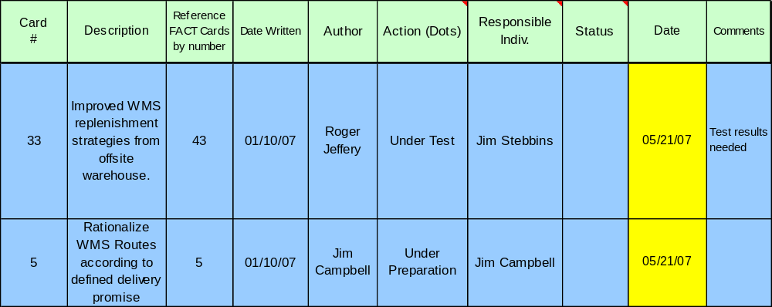
Electronic transfer of all IMPROVEMENT Card data
CEDAC Problem Solution
Notes:
SAY: Use this spreadsheet for this event week and to keep track of open actions for follow-up going forward. May also use this format to retain sustainability and impact data after implementation.
NOTE: Establish one “owner” of this spreadsheet OR designate an update process and post on shared drive for regular update (however business prefers to handle).
SAY: Enter all IMPROVEMENT card data into spreadsheet with column headings as follows:
Card # = Improvement Card #
Description = Improvement Action Identified
Reference Fact Cards by Number = the FACT card(s) which this improvement action addresses
Date Written = Date Written
Author = Author
Action (Dots) = refers to the CEDAC Dot System for statusing IMPROVEMENT Cards
Responsible Individual = an individual should be assigned wherever The "Action" is Under Preparation, Under Test or Successful Test & where further rollout of the new standard is required.
Status = reflects status of current assigned action by responsible person
Date = Date of last update
Comments = for additional pertinent information

Slide 89
CEDAC Step 7 Exercise: Prioritize IMPROVEMENT Cards
CEDAC Problem Solution
Objective
Prioritize IMPROVEMENT Cards for the business problem.
Instructions
Time to Complete
As a team, follow the process outlined on the previous slides to prioritize the
IMPROVEMENT Cards.
Capture all of the IMPROVEMENT Card data electronically and assign people responsible and dates for when action will go to next step.
Determined by facilitator
Deliverable
IMPROVEMENT Cards prioritized. All IMPROVEMENT Card data transferred electronically

Slide 90
CEDAC Step 8 - Follow-up Process through to Problem Resolution
CEDAC Overview
CEDAC Effect
CEDAC Cause
CEDAC Solution
CEDAC Review
Objectives:
Describe the Follow-up Process
  Adding FACT Cards
  Adding IMPROVEMENT Cards
  Gaining additional buy-in from stakeholders
Discuss tracking and management of periodic review process
Determine structure and details for how team will conduct follow-ups to the CEDAC event
Notes:
DO: Review chapter objectives.

Slide 91
Steps of the CEDAC Process
CEDAC Problem Solution
Define problem
Establish and validate metrics
Determine Objective Statement
Create CEDAC diagram (Flowchart, Fishbone, etc.)
Brainstorm and create FACT Cards (in yellow) and post on diagram
Brainstorm and create IMPROVEMENT Cards (in blue) and post on diagram
Take action on the IMPROVEMENT cards
Institutionalize improvements (countermeasures) that have proven to solve the problem
The “Effect”
The “Cause”
The “Solution”
(countermeasures)
Notes:
SAY: “No change can be proven without the data to support that it has in fact addressed the root cause and eliminated the variation causing the defect or undesired condition.”

Slide 92
The Follow-Up Process
CEDAC Problem Solution
Update IMPROVEMENT cards with countermeasure test results (DOT system)
Track Problem / target metrics to confirm impact of actions
Continue taking action on IMPROVEMENT cards marked for action, as prioritized earlier
Add new FACT cards as additional data becomes available
Add new IMPROVEMENT cards to address new FACT cards, and to address further investigation of original FACT cards
Conduct CEDAC follow-up events, as needed to achieve problem resolution and achieve target objective
Implement changes and adjustments to countermeasure priorities and implementation plans, according to the metrics and results achieved

Slide 93
Tracking and Management of Periodic Review Process
CEDAC Problem Solution
Establish process for update and review of improvement actions
Ensure clear roles and responsibilities are defined and assigned
Update metrics daily/weekly to show progress
Include other associates as needed
Standardize improved processes for similar business needs
Ensure improvements are sustainable and documented

Slide 94
CEDAC Step 8 Exercise: Follow-up Process
CEDAC Problem Solution
Objective
Determine the details of the Follow-up Process for this CEDAC event.
Instructions
Time to Complete
As a team, decide how you will conduct the follow-ups to the CEDAC.
Identify the rules.
Identify roles and responsibilities and assign ownership.
Identify metric(s) of success
Determined by facilitator
Deliverable
IMPROVEMENT Cards prioritized. All IMPROVEMENT Card data transferred electronically

Slide 95
Prepare for Final Report-Out to Management
CEDAC Problem Solution
All team members should contribute to the final report-out presentation to management
Report-out should include
  Introduction of Team
  Review of Event goals and objectives
  Review of Former Process and Documentation Forms
  Review of Improvement Opportunities Identified and Implemented
  Review of CEDAC Follow-Up Process
Typical Report-Out times are 15 minutes for presentation and 15 minutes for questions
Notes:
DO: Cover report-out guidelines.

Slide 96
CEDAC Review
CEDAC Overview
CEDAC Effect
CEDAC Cause
CEDAC Solution
CEDAC Review
Objectives:
Review Benefits of CEDAC
Review CEDAC Roadmap
Discuss Key Learnings
Notes:
DO: Review chapter objectives.

Slide 97
Review - CEDAC Benefits
CEDAC Review
Brings problem solving out of the meeting room, eliminating “another one hour meeting each week”
Involves everyone in the continuous improvement process
Is visually displayed in the work place providing easy access
Covers every step in the problem solving process in one technique
Quantifies the effect and tracks progress providing immediate feedback for successful solution implementations
Is flexible; board design is limited only by extent of imagination; it does not require the fishbone format be used exclusively
Notes:
SAY: “CEDAC involves everyone in the continuous improvement process, even those not directly working on the problem.”
DO: Review the benefits of the CEDAC process.
ASK: “Are there any other benefits that you can think of?”
DO: Record any other benefits on a chartpaper.

Slide 98
Review - CEDAC Roadmap
CEDAC Review
Repeat until problem is solved
PROCESS STEP 1
PROCESS STEP 2
PROCESS STEP 3
PROCESS STEP 4
Conduct CEDAC Planning Workshop
Conduct CEDAC
Event
Implement and Test Countermeasures
Conduct CEDAC Follow-up Workshops
Identify the Problem
Validate problem using metrics
Identify target
(When is the problem solved?)
Plan CEDAC Event
CEDAC Chart
FACT Cards posted
IMPROVEMENT Cards posted
IMPROVEMENT Cards marked for action
Follow-up Plan
Countermeasure Test results
Problem / target metric tracking
IMPROVEMENT CARDS marked for action
Additional FACT Cards
Additional IMPROVEMENT Cards
Changes and adjustments to countermeasure priorities and implementation plans
Notes:
SAY: “The process of improvement never truly ends. What is good enough today will no always be so in the future. The process of CEDAC and Problem Solving can and will be repeated until the root issue is resolved.”
(SAY if Six Sigma is well understood by audience): “Much like the process of DMAIC in Six Sigma this method of variance reduction holds true to the same principles.”
Define
Measure
Analyze
Improve
Control

Slide 99
CEDAC Exercise: Review Key Learnings
CEDAC Review
Objective
Discuss key learnings from this CEDAC event.
Instructions
Time to Complete
In pairs, spend 5 minutes discussing key learnings and take-aways from this CEDAC Event
One person from each group will share one learning with the rest of the class
5 minutes
Deliverable
Report-out of key learning to rest of class

Slide 100
Appendix
History of CEDAC

Slide 101
History of CEDAC
Cause-Effect “Fishbone” Diagram (aka: Ishikawa Diagram) was named after it’s originator, Kaoru Ishikawa, who first used them in the shipyards in Kobe Japan in the 1960’s
  The Cause Effect Diagram has been a standard QC tool for several decades
CEDAC developed by Ryuji Fukada in the mid-1970’s while working at Sumitomo Electric in Japan
  CEDAC piloted in 350 projects in 40 Sumitomo plants
  Awarded the Japanese Deming (Nikai) prize in 1978 for a paper on the subject
  Published Book: CEDAC: A Tool for Continuous Systematic Improvement, 1996, Productivity Press
CEDAC has been accepted and is widely used today as a Lean transformation and quality improvement tool and method
  CEDAC has been successfully adapted for use with process flows and other baseline maps in addition to Cause-Effect diagrams

Slide 102
Other Modules In This Series:
5S
Standard Work
Total Productive Maintenance (TPM)
Administrative Lean
Cell Design/ Production Preparation Process (3P)
Kaizen
Kanban
Problem Solving
Poka Yoke Quality Systems
Transaction Process Improvement (TPI)
Cause & Effect Diagram with the Additions of Cards (CEDAC)
Single Minute Exchange of Dies (SMED)
Value Stream Mapping (VSMi®)
Visual Management
Managing Daily Process Excellence
For More Information Please Contact:
Mark DeLuzio, President and CEO
+1.860.234.0915
mark.deluzio@leanhorizons.com
Strategically Creating Value Through the Elimination of Waste

